Slide 1
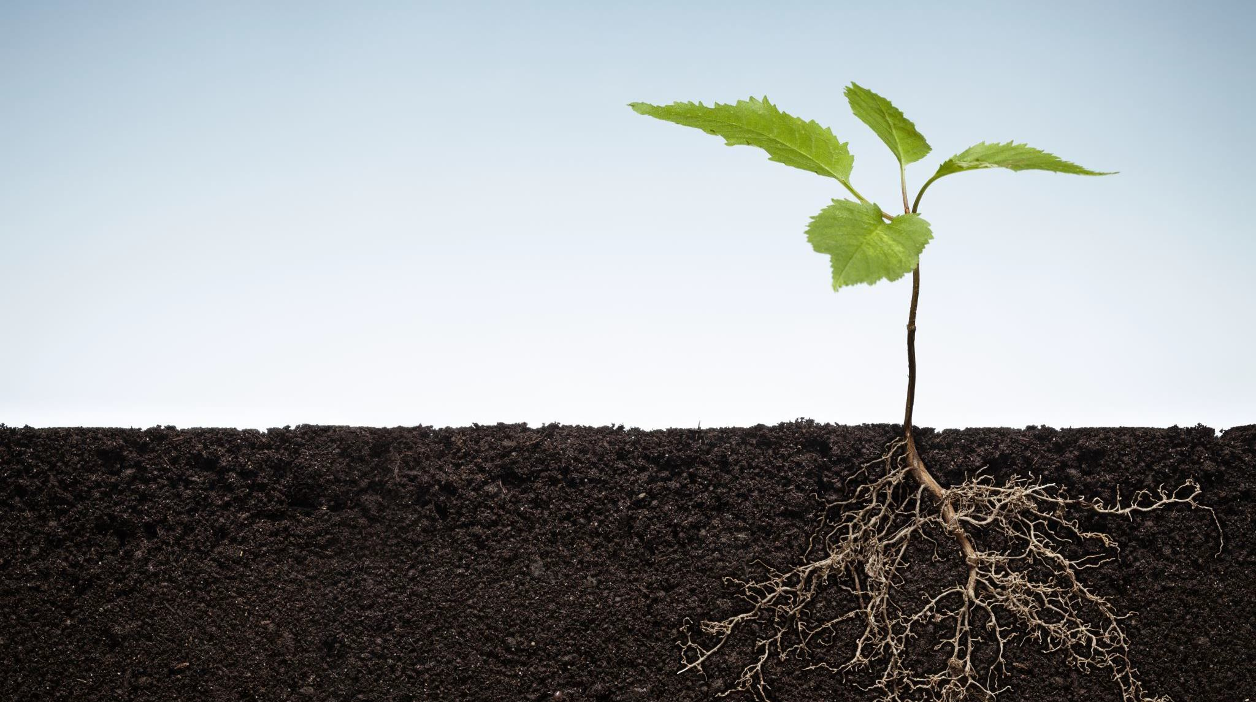
Beginning Gardening
Milton Public Library
April 6, 2021

Slide 2
A Few Key Questions to think about!
What foods do my family and I love to cook and eat with?
What is easy to grow for a beginner?
How much sunlight do I have?
Where should I plant the garden?
Do I want to use containers, mounded beds or wooden raised beds?
What is the quality and composition of my soil?
What are the first and last frost dates in my area?
When do I plant each type of crop?
How much time and energy do I have to devote to this endeavor?

Slide 3
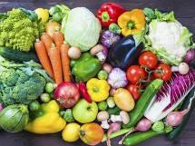
Radishes, tomatoes, peppers, carrots, chard, lettuce and beans are easy to grow for a beginner.
Broccoli, carrots, kale, mustard, beet and turnip greens, spinach, winter
squash, tomatoes are the most nutrient dense.
Carrots, parsnips, winter squash, dry beans, onions, herbs (dried) and potatoes store well.

Slide 4
Where Oh Where will my garden grow?
It’s all about Location, Location, Location!
Choosing a site
Sunlight – 6 to 8 hours a day
Soil – well drained fertile soil
Surrounding vegetation – Trees and shrubs compete with moisture and nutrients
Convenience – Water source, ease of maintenance and harvesting

Slide 5
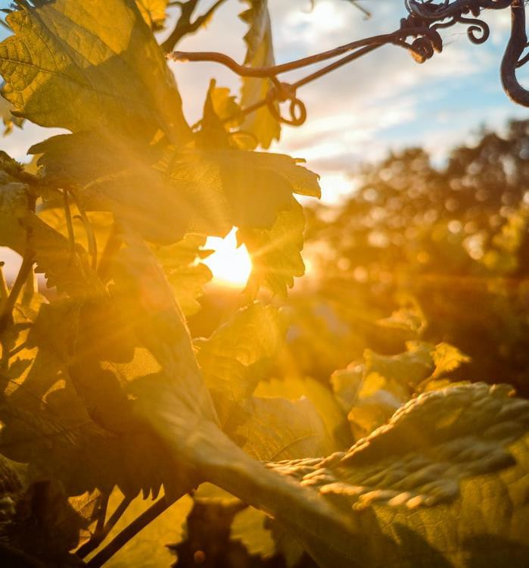
Sunlight in the garden
6+ hours of full sun for warm season crops
4-6 hours full sun for cool season crops
Note the position of the sun and how it might change over the course of the growing season.

Slide 6
Soil and Soil Types
Soil is formed when rock is broken down by climate and vegetation over a period of time. Soil is weathered rock fragments and decaying remains of plants and animals also known as organic matter (OM). It contains varying amounts of air, water, and micro-organisms and furnishes mechanical support and nutrients for growing plants.
Soil types are defined by the texture of the soil or the fineness/coarseness of the mineral particles in the soil.
Sand has coarser mineral particles and feels rough when rubbed between he thumb and fingers.
Clays are the finest soil particles. They feel extremely smooth when dry and become slick and sticky when wet. Clay will hold the form into which it is molded.
Silt is fine soil particles that feels smooth and floury. When wet, silt feels smooth but not slick or sticky. When dry, it is smooth and if pressed between the thumb and finger, will retain the imprint.
Loam is a textual class of soil that has moderate amounts of clay silt and sand. Loam contains approximately 7% to 27% clay,
28% to 50% silt and 50% sand.

Slide 7
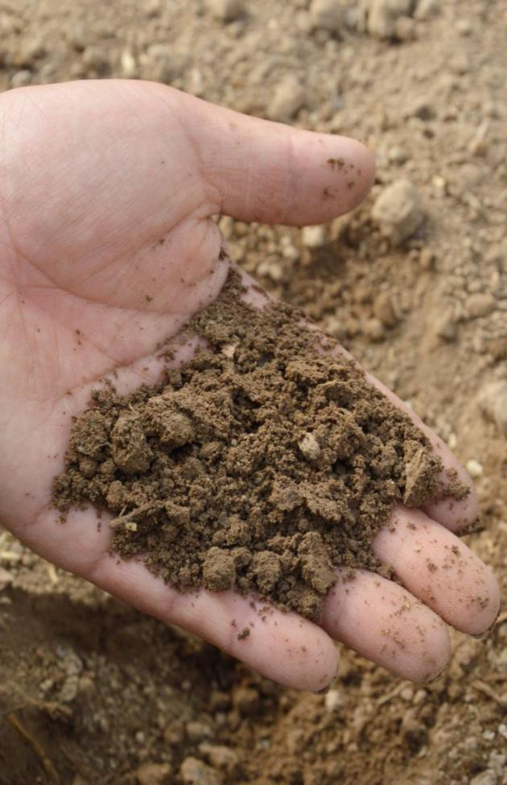
Sand
Sandy soil is easy to spot by its feel. It has a gritty texture and when a handful of sandy soil is squeezed in your hand, it will easily fall apart when you open your hand again.

Slide 8
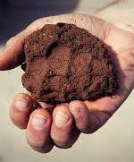
Clay
Clay soil has the finest soil particles so it has good water storage qualities. It's sticky to the touch when wet, but smooth when dry. ...
If moistened soil feels sticky, rolls up easily, and forms into a ball or sausage-like shape, then you've got yourself clay.

Slide 9
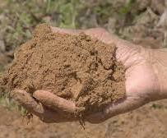
Silt
Silt soil is fine and feels almost floury to the touch when dry. When wet, it becomes a smooth mud that you can form easily into balls or other shapes in your hand. When silt soil is very wet, it blends seamlessly with water to form fine, runny puddles of mud.

Slide 10
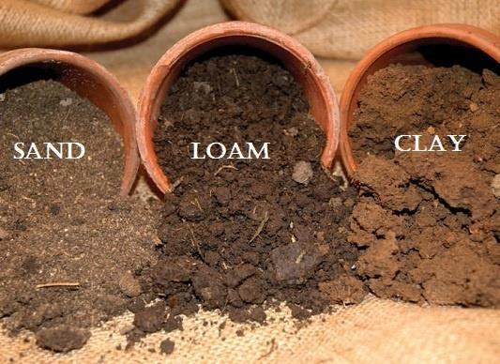
Loam
Loam is soil composed mostly of sand, silt, and a smaller amount of clay. By weight, its mineral composition is about 40–40–20% concentration of sand–silt–clay, respectively.

Slide 11
Why is soil texture important?
The texture of a soil is important because it determines soil characteristics that affect plant growth. Three of these characteristics are water-holding capacity, permeability, and soil workability. Water-holding capacity is
the ability of a soil to retain water.
Permeability refers to the movement of air and water through the soil, which is important because it affects the supply of root-
zone air, moisture, and nutrients available for plant uptake.

Slide 12
Soil Drainage
Water drains quickly indication of a sandy soil. Trouble keeping you garden moist.
Water drains very slowly indication of clay. Water puddles when wet and cracks when dry.

Slide 13
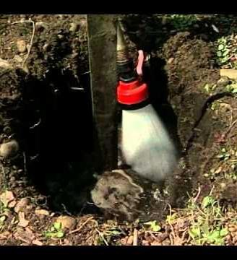
Simple Percolation Test
Dig a hole 12 inches deep and 12 inches across
Fill the hole with water and let it drain
Fill the hole again with water and measure the change in water level every hour.
Ideally a well drained soil will drain 2 inches every hour.

Slide 14
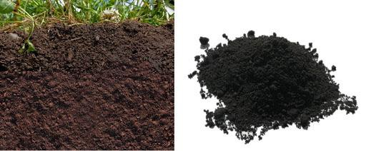
Amending the Soil
Organic Matter
Organic Matter (Humus)
Improves plant growth
Has high water holding ability
Good for storing nutrients and is
useful for micro-organisms
Binds tiny soil particles and improves soil structure
Brownish/black color that absorbs heat

Slide 15
What is Organic Matter or Humus
Soil organic matter (SOM) is made up of living plants and animals (roots, fungi,
bacteria, macro fauna and micro fauna), plant litter, and all the degraded material from decomposing plant and animal material (manure).

Slide 16
Other considerations for
location of
Location of trees and shrubs around the garden area – Competition for moisture and nutrients.
Convenience – Water source
Ease of maintenance
Harvesting
History of Site
Septic system and leach field
your garden

Slide 17
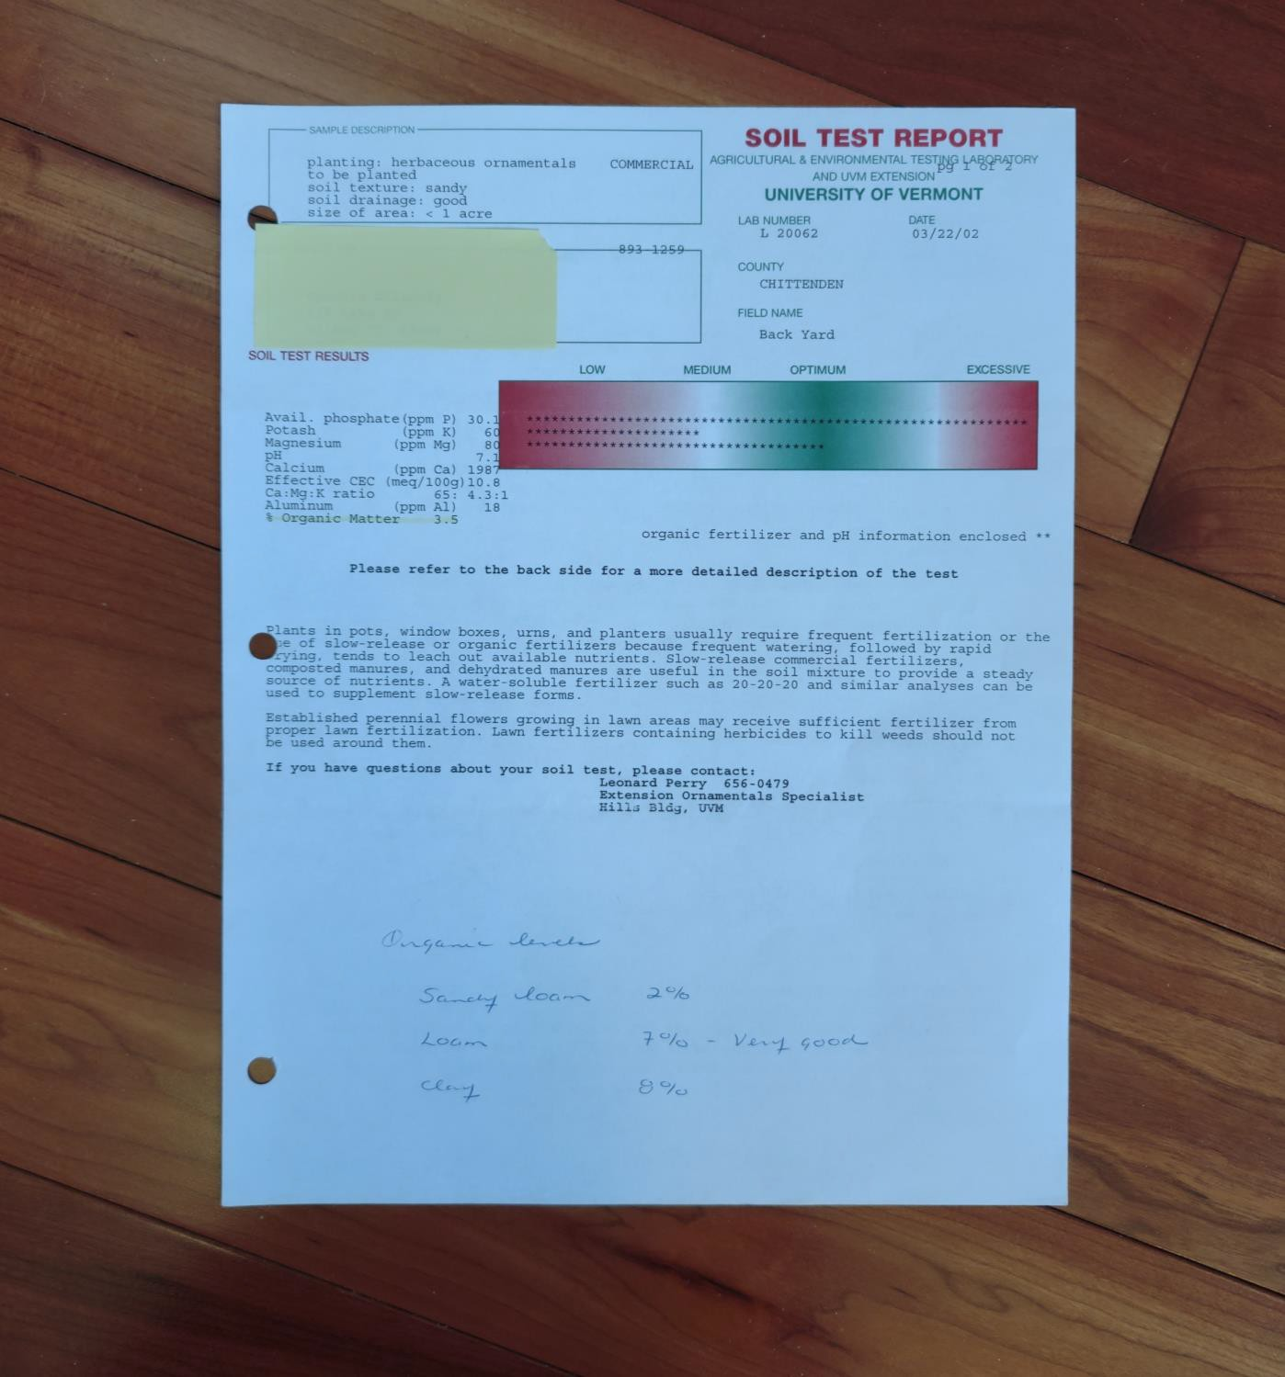
Soil Testing
Soil PH –measures the degree of acidity or alkalinity of the soil
6.2 to 6.8 ideal for most gardens
Add lime to raise PH
Add sulfur to lower PH ( Blueberries)
Soil test by UVM lab- Measures soil
fertility or organic matter (OM)
in the soil.
https://www.uvm.edu/newsstories/news/does- your-soil-get-passing-grade

Slide 18
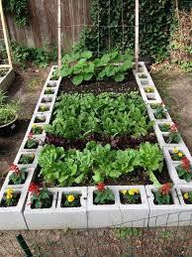
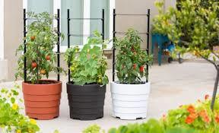
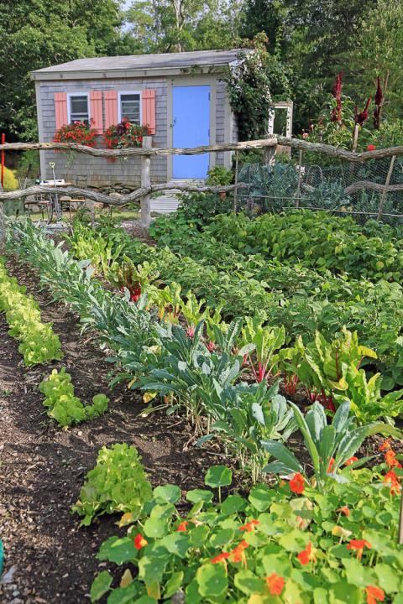
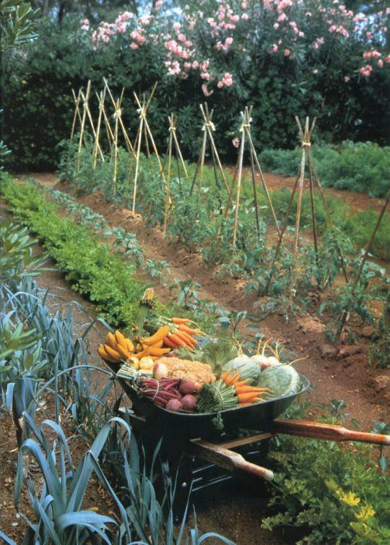
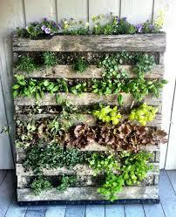
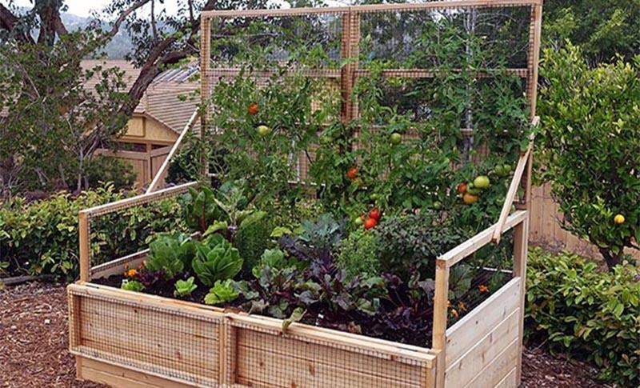
Garden Ideas
Ga

Slide 19
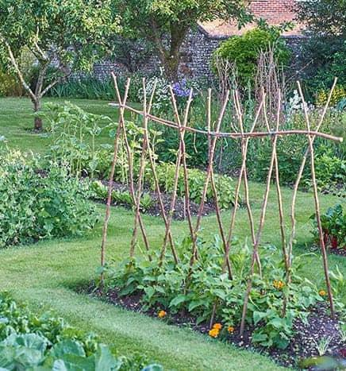
Inground gardening
Start small
8 X 10 ft space is a good size
Digging your beds
Loosen the top 6-12 inches of soil
Rototill, sod cutter, by hand or
Mow close and cover with cardboard, tarp or old rug for 3 to 4 weeks
Amend the soil by adding organic
matter (manure, leaf mold, compost)

Slide 20
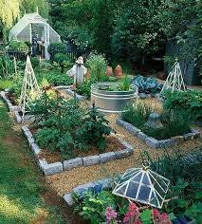
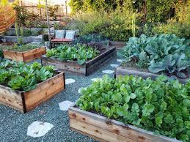
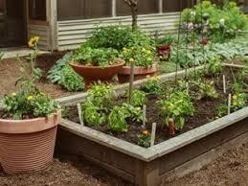
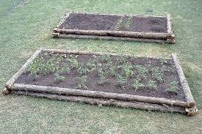
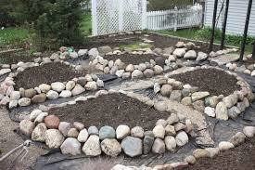
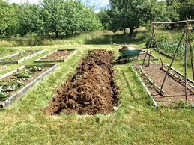
Raised bed gardening

Slide 21
Raised beds
Shallow or poor soil - 1 cubic yard of purchased garden loan will adequately fill 2 3 X 5 ft beds
Easier on back and clearly defines area
Size should be not more than 4 ft across so that you can reach to the center without stepping in the bed and the
bed can be as long as you want it to be. Depth should be at least 6 inches deep, but 12 inches is better for the deep
-rooted vegetables.
Start by choosing your site and defining the area of the garden with a built raised bed or material of your choice.
In most cases, cedar is the best wood to use for garden beds because cedar is naturally rot resistant. Western red cedar is commonly used, but Vermont white cedar, Port Orford (yellow) cedar and Juniper are also high-quality choices for outdoor construction projects. Hemlock is also an appropriate wood to use and is cheaper than cedar. DO NOT used pressure treated wood.
Layer newspaper or cardboard at the bottom right on top of the grass and fill bed with 60% topsoil. 30% compost
and 10% Potting soil (a soilless growing mix that contains peat moss, perlite and/or vermiculite).
https://www.gardeners.com/how-to/raised-bed-buying-guide/9564.html

Slide 22
Layer Gardening No Dig, No Till
Start 6 months before planting.
Can use either raised beds or in ground gardening
Place Newspaper or cardboard at he bottom and soak with water. No glossy
print.
Layer with nutrient rich layers of compost, manure and grass clipping alternating with a carbon rich layer of straw, newspaper and shredded leaves.
joegardener.com/podcast/easy-no-dig-gardening-charlie-nardozzi/ or
“The Complete Guide to No Dig Gardening” by Charlie Nardozzi

Slide 23
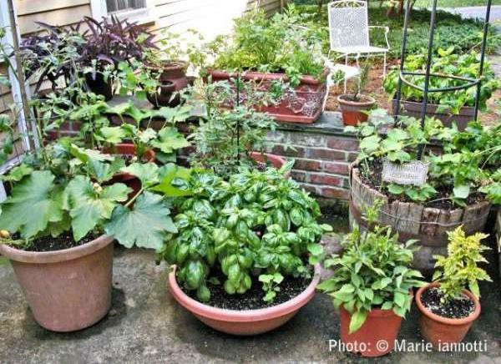
Container Gardening
Need a site that gets lots of sun
Need to water more frequently
Do not use garden soil by itself
Soilless media
Compost up to 25%
Fertilize regularly using a water- soluble fertilizer

Slide 24
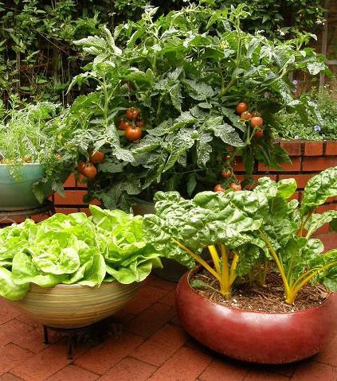
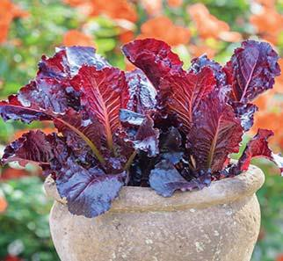
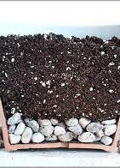
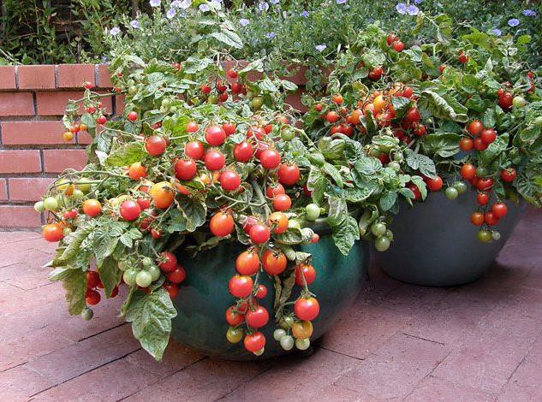
Tips for Container Gardening
Good drainage
Choosing varieties of plants that are compact and suitable for containers
Choose the correct container size for the vegetable you are growing

Slide 25
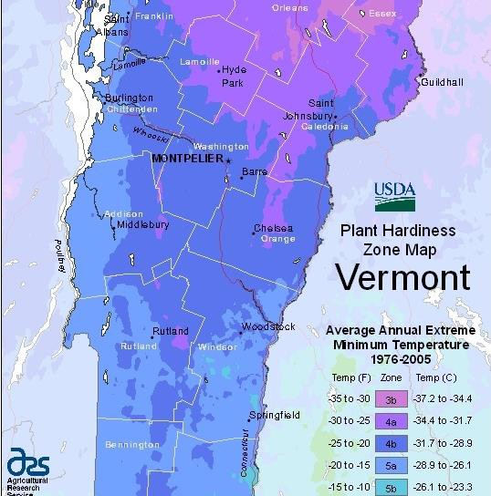
Frost Dates
This will vary with area, the first frost date in fall in USDA hardiness zone 5 is around the first week of October, about 10 days earlier in zone
4. In the spring, the last frost date is around the second week of May in zone 5, and about 10
days later in zone 4. These zones refer to average annual minimum temperatures.
Since cold air is heavier than warm air, it tends to sink into valleys. Mountaintops, too, are
generally colder than lower elevations. For these reasons, frosts usually come first in these areas while hillsides remain frost-free. Similarly, on
even a smaller or “microclimate” scale, some parts of a particular property such as low areas may be more prone to frost than areas near warmer pavement or buildings.

Slide 26
Planting Time!
A soil thermometer is a helpful tool especially in the spring as it can help you determine which crops to plant depending on the soil temperature.
40 – 50 degrees F
Peas, radishes, carrots, beets, swiss chard, potatoes, onions, kale, lettuce, spinach, broccoli, cauliflower
50 -60 degrees F
Cilantro, corn, tomatoes (transplants) cucumbers
60 – 70 degrees F
Snap beans, eggplant, pepper, melons, pumpkins, squash, zucchini, basil and other herbs
https://www.uvm.edu/sites/default/files/Extension-Master-Gardener/Planting_the_Garden.pdf

Slide 27
Materials
Visit your local nursery and ask for recommendations for organic seeds,
plants, compost, and fertilizer.
Soil test - UVM Soil Test UVM Agricultural and Environmental Testing Lab
Tools
Fertilizer – LD Oliver Seed Company in Milton - North Country Organics Pro-Gro, Pro Start and Pro Holly
Compost - Green Mountain Compost for large quantities (Trucking available)
Hose or irrigation line or water lines and extra faucets
Watering can
Seed and seedlings High Mowing and Johnny’s Hudaks UVM Greenhouse Gardener’s Supply
Labels
Fencing
Loam to fill raised beds
Framing Materials

Slide 28
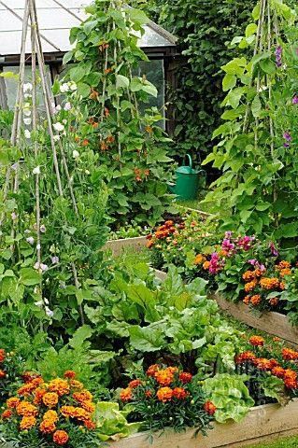
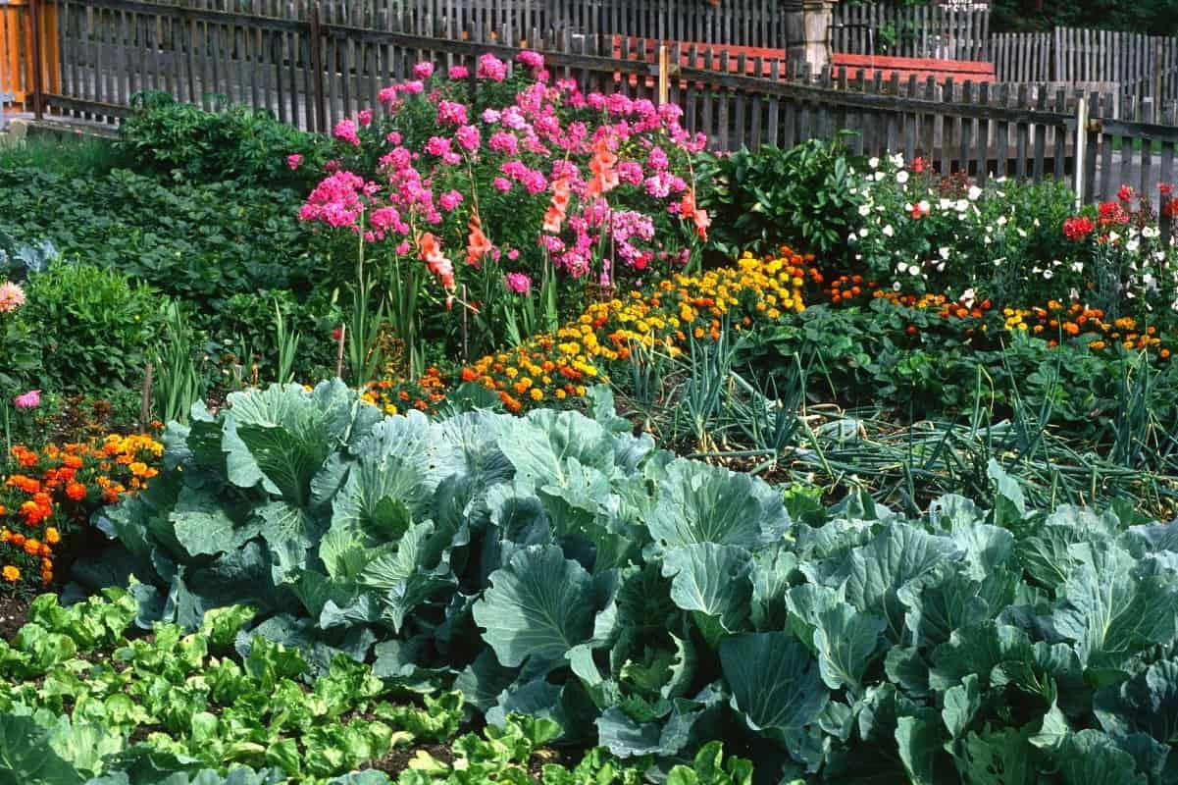
Flowers in the Vegetable Garden
Attracts pollinators
Helps with managing weed
Pest and disease control
They are beautiful!

Slide 29
Recap
Pick a site that gets enough sun
Check your soil texture and drainage
Submit a soil test
Start killing grass and prep your site as early as possible
Other options includes raised beds and container gardening
Initial investment
Most important – Have Fun!!

Slide 30
Questions and Resources
UVM HELPLINE
https://www.uvm.edu/extension/mastergardener/helpline
https://www.uvm.edu/extension/mastergardener/gardening-resources
https://extension.umaine.edu/gardening/manual/vegetables/
National Gardening Association magpie@nationalgardening.org
https://www.gardeningwithcharlie.com/how-to-grow-no-dig-gardening/
University of Iowa and Cornell University are excellent online resources
love2gardenvt@gmail.com That’s me!

Slide 31
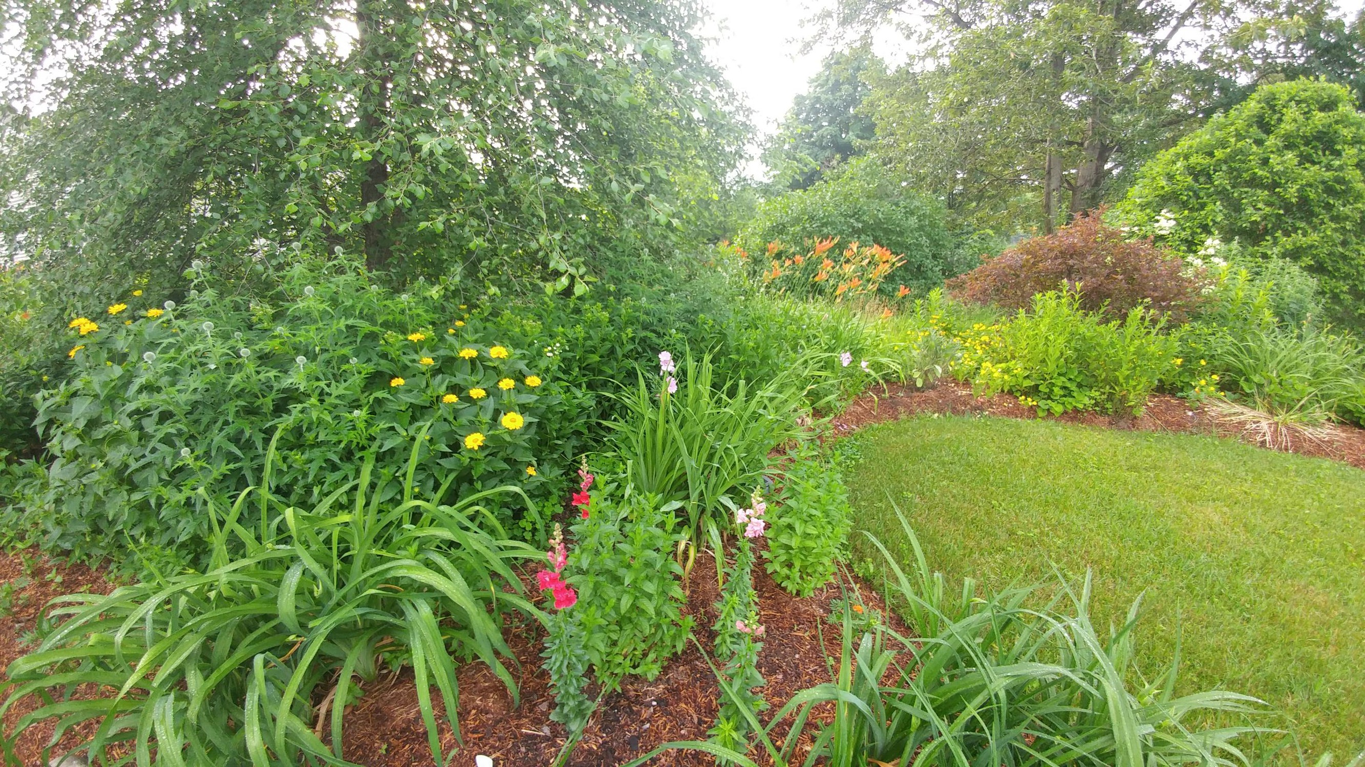

Slide 32
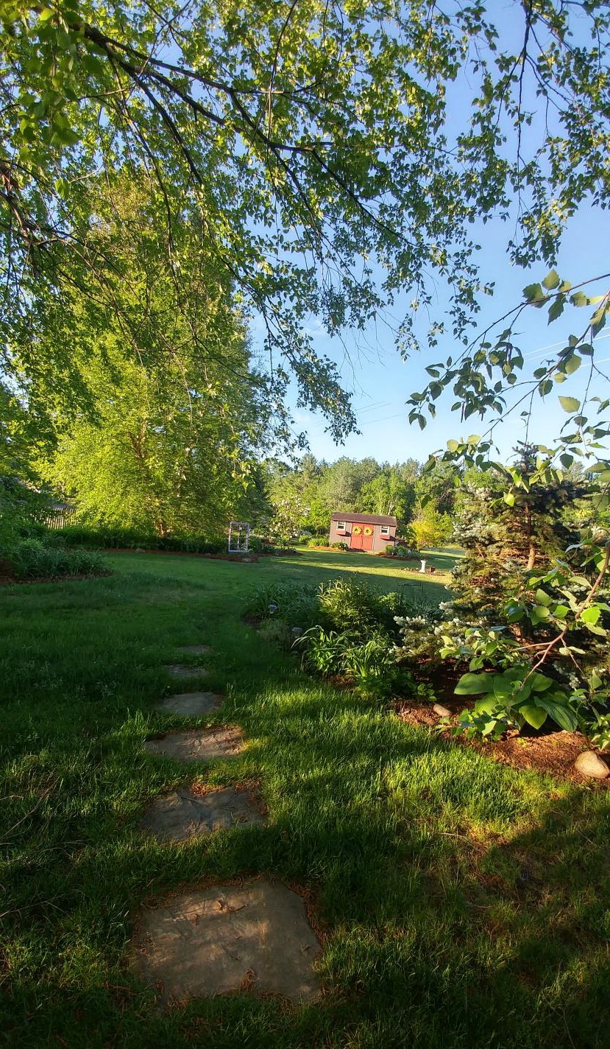
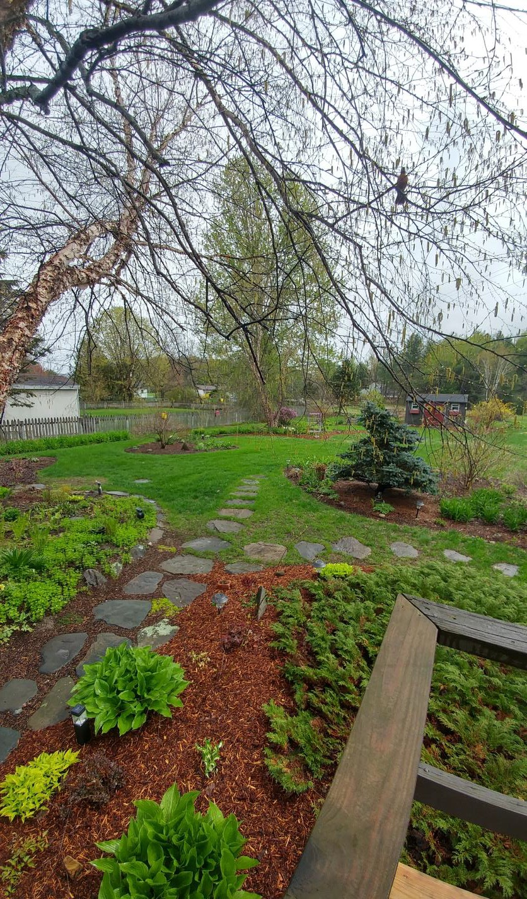
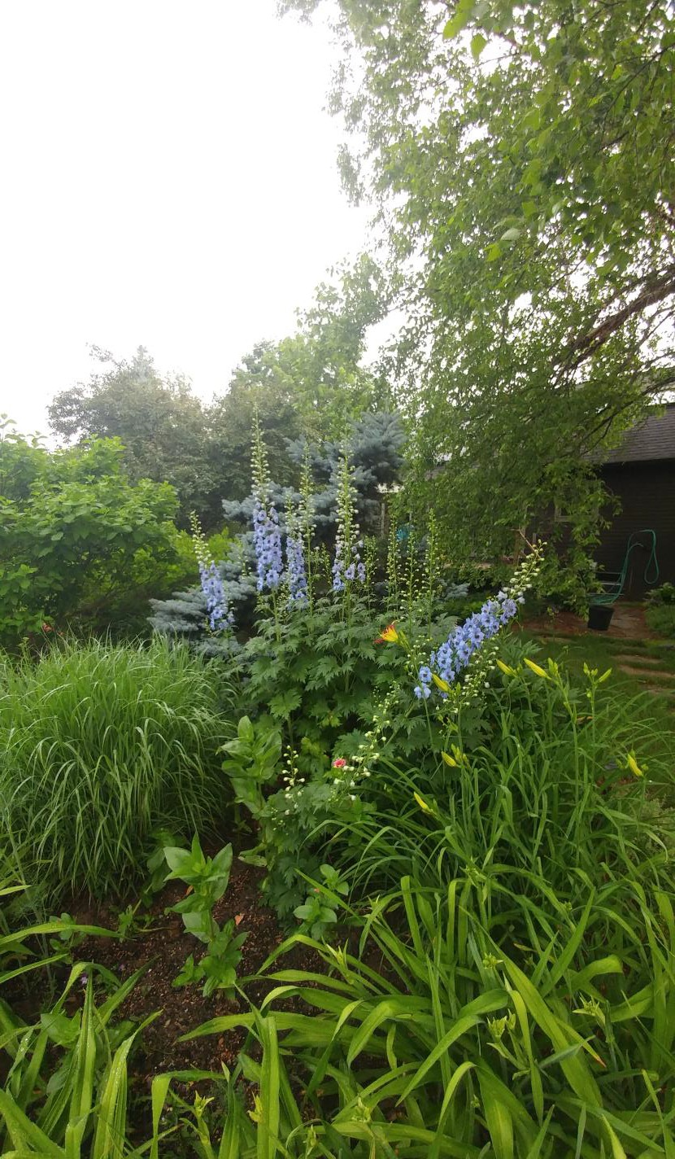

Slide 33
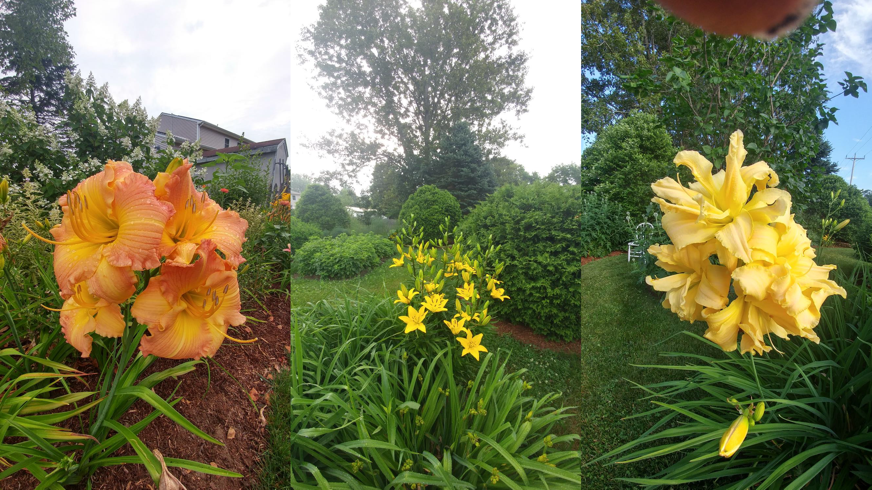

Slide 34
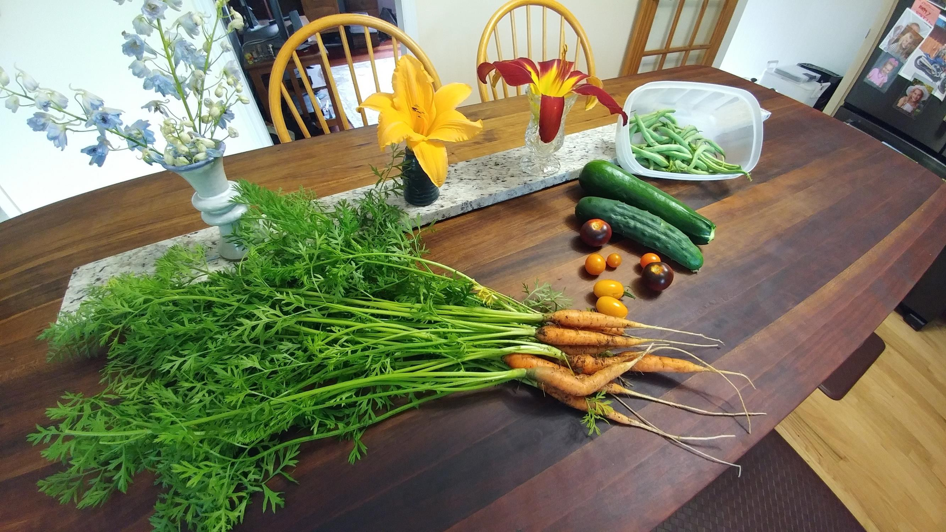

Slide 35
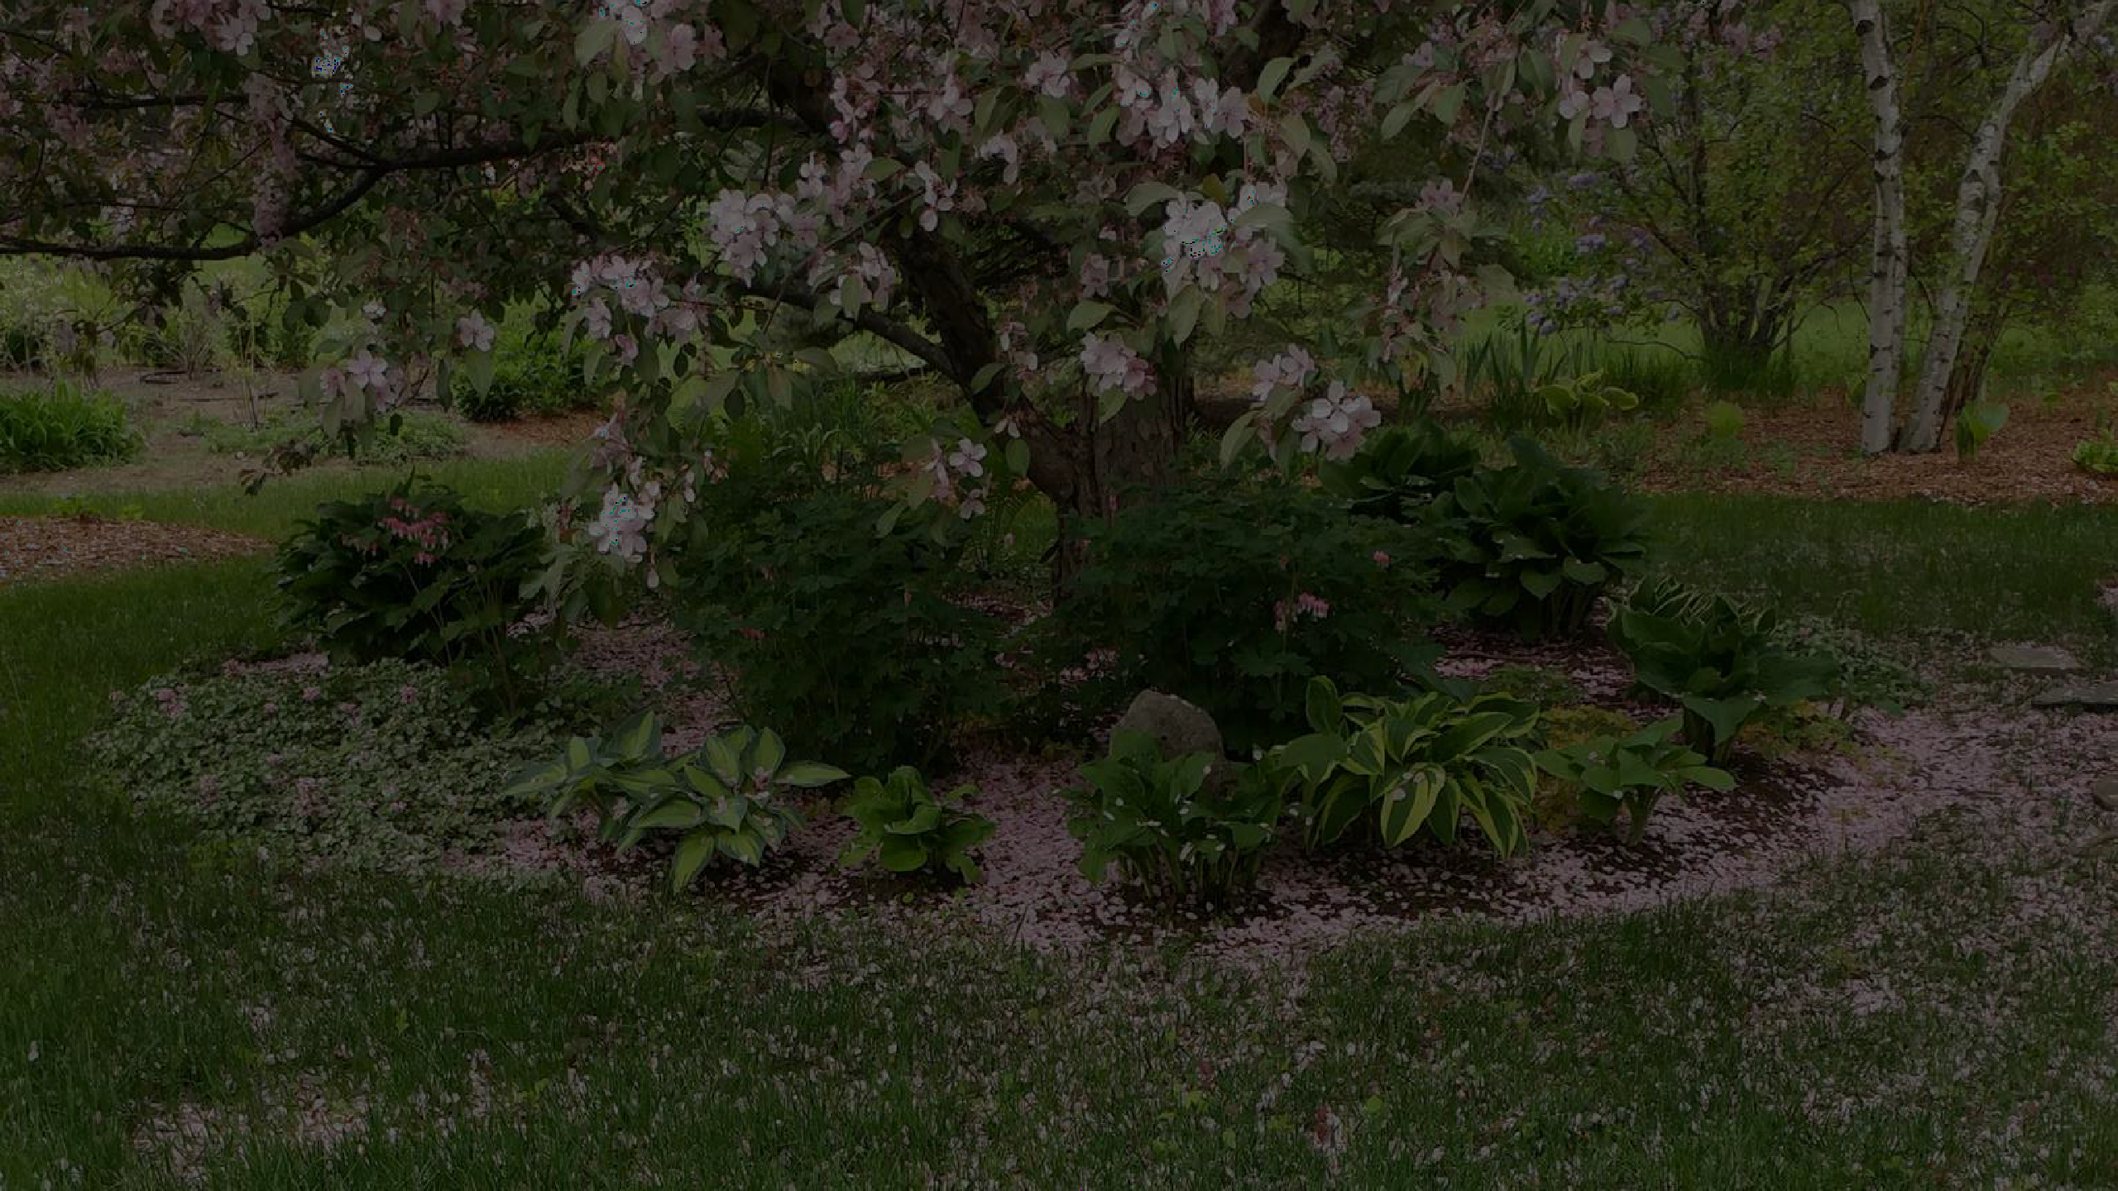
THE LOVE OF GARDENING IS A SEED THAT ONCE SOWN NEVERS DIES
BUT GROWS TO THE ENDURING HAPPINESS THAT THE LOVE OF GARDENING GIVES
GERTRUDE JEKYLL

