Slide 1

Food Safety Outreach Project Round Table
December 16, 2019

Slide 2

Food Safety Outreach Projects, Evaluation Summary
Dr. Amy Harder, University of Florida, amharder@ufl.edu
USDA-NIFA, FSOP Competitive Grants Program
{Completed}
Problem Statement / Issue Definition:
Determine outputs and outcomes from food safety training, education, extension, outreach, and technical assistance projects that were awarded between 2016-2018
Approach / Methods:
Thematic analysis of funded project narratives
Qualtrics survey of project directors
  Primarily close-ended questions
  Open-ended success story option
Results / Outcomes:
Comprehensive report available from the LRCC
374 trained PSA participants; 68 trained FSPCA participants, 1,262 participants in “other” trainings
Major emphasis on curriculum development and adaptation of existing curriculum for special populations
Creation of 22 printed resources, 18 online resources, 3 videos, 3 smartphone applications, 2 audio resources
Creation of technical assistance network, 3 advisory panels, 2 stakeholder communication platforms
Food Safety Outreach Project Round Table

Slide 3

Supporting underserved California leafy-green producers’ FSMA compliance, through interdisciplinary food safety, communication and marketing training
Karen Cannon, Cal Poly, kcanno01@calpoly.edu (with Jeta Rudi Polloshka, Amanda Lathrop, Erin Krier)
USDA-NIFA, FSOP – Community Outreach Projects
Initial Stage, 2019-2021
Problem Statement / Issue Definition:
Leafy greens – important crops for the state of California – are often recalled due to pathogen contamination. This may lead to a decrease in consumer confidence, and a negative impact for the industry. As FSMA regulation becomes enforceable for very small operations, farmers in the Central Region of California are in a need for training and expertise.
Growers in small and very small operations may lack the language skills and understanding of food safety regulation. These farmers often sell their produce directly to consumers, at farmers’ markets. Literature suggests that farmers’ markets are linked to higher incidences of foodborne pathogen contamination outbreaks. Our goal is to train farmers in food safety best practices, and hence help reduce incidents of food safety outbreaks.
Approach / Methods:
We focus on farmers of leafy greens in the Santa Maria region of California. Out training program is interdisciplinary, including food science, plant science, agribusiness, and agricultural communication. We conduct the training in two phases:
Phase 1: Farmers and students are offered Produce Safety Alliance (PSA) grower training
Phase 2: Visits to farmers’ operations to offer them a training program including consultation on the Produce Safety Rule, food safety cost tracking and agribusiness training, and food safety crisis communication training.
All trainings include Cal Poly and Allan Hancock College students, who will be assisting the project directors in all phases of the project. By including students in our project, our goal is to increase California’s future capacities in food safety.
Results / Outcomes:
Expected results include: 1. Forty farmers and students trained using the PSA model, and 2. Growers of fifteen operations will undergo the interdisciplinary food safety training at their operations.
More broadly, our goal is to train the California leafy greens industry on food safety compliance in a hope to significantly reduce food safety outbreaks in these healthful products. Similarly, our goal is to increase food safety capacities in California and beyond, by training our students on food safety issues and regulation compliance.
Food Safety Outreach Project Round Table

Slide 4
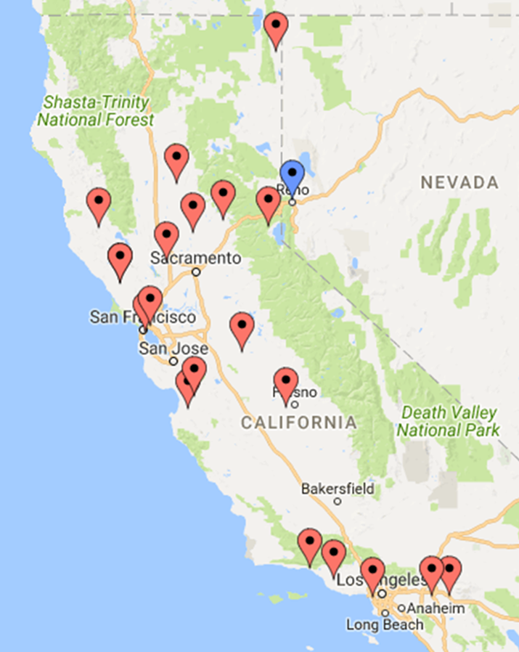
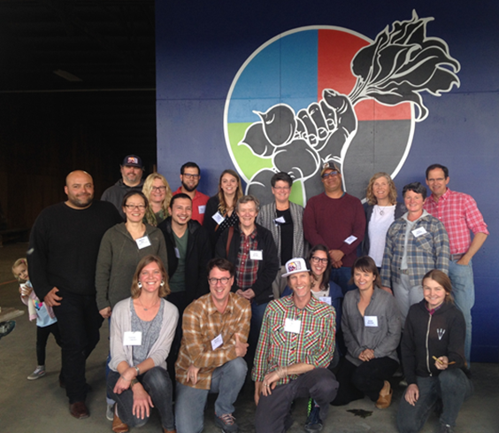


Supporting FSMA compliance for California’s regional food hubs through training and technical assistance
Erin DiCaprio, UC Davis, eldicaprio@ucdavis.edu
End 8/31/2020
Food hubs support regional food systems
Food hub facilities, equipment, employees, types of commodities sold, and ownership vary
Many of the food hubs do not have resources to implement to PCHF Rule
Webinars (Nov 2018 – Jan 2019)
Overview of PC Rule
Qualified exemptions
PC Rule fully covered facilities
PCQI training (Jan 2019)
Site visits
Review of food safety plans
Fact sheet on implementation
Model food safety plan
How would you rate your knowledge of the FSMA Preventive Controls for Human Food Rule … ? (n = 12) | PRIOR to attending the FSPCA Hybrid course | AFTER attending the FSPCA Hybrid course
Very knowledgeable | 0% | 50%
Somewhat knowledgeable | 67% | 50%
No previous knowledge of requirements | 33% | 0%
Food Safety Outreach Project Round Table

Slide 5
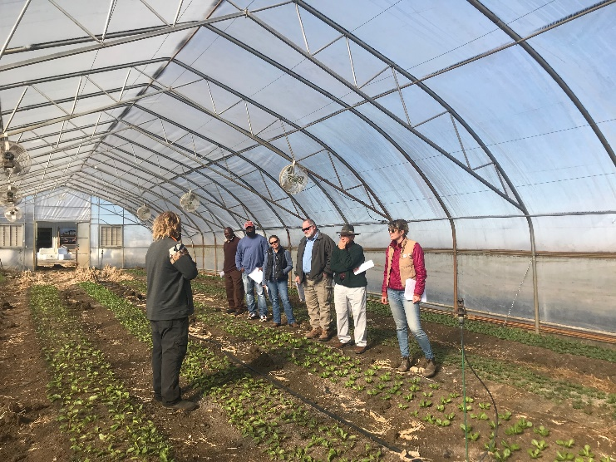

Produce Safety Spring Training: Engaging Beginning Farmers With Timely and Practical Guidance to Build a Community of Food Safety Practitioners
Cara Fraver, National Young Farmers Coalition cara@youngfarmers.org
NIFA, FSOP
Funded
Problem Statement / Issue Definition:
In many states, beginning farmers are still lacking the real resources they need to improve their produce safety
Approach / Methods:
Tailored to Beginning Farmers and Voluntary Compliance
Peer Learning and Sharing
Tangible, Specific Outcomes
Integrating Food Safety with Business Planning
Trusted (and Non-Regulatory) Advisor
Results / Outcomes:
4 yearly regional food safety tours- 1 PSA, 3 Deeper Dive, Group walkthrough, one-on-one walkthroughs
Online interactive food safety plan writing cohort
Online, curated, practical resources
Food Safety Outreach Project Round Table

Slide 6
Experiential Learning Opportunities for Limited Resource Growers through Mobile Farm Innovation Centers in Mississippi, Alabama, and Georgia
Billy Mitchell, Local Food Safety Collaborative, bmitchell@nfudc.org
NIFA FSOP
Problem Statement / Issue Definition:
Meet critical challenges faced by growers balancing food safety and conservation concerns.
Approach / Methods:
Experiential learning and face-to-face technological support.
Develop three Mobile Farm Innovation Centers equipped with experiential, visual, and technological training aides.
A curriculum that includes modules on Whole Farm Planning, balancing food safety and conservation concerns.
Results / Outcomes:
Increased access to existing food safety materials, greater understanding of balancing food safety and conservation needs, increased farm viability.
Food Safety Outreach Project Round Table

Slide 7
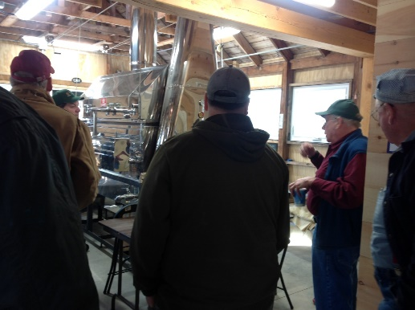

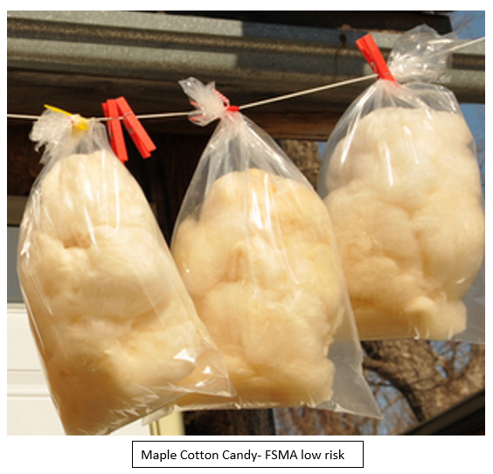

Assisting Maple Syrup Producers to Comply with the Preventive Controls for Human Food Rule of FSMA
Heather Bryant, UNH Extension, heather.bryant@unh.edu
USDA/NIFA Food Safety Outreach Program – grant # 2018-70020-28850/project accession no.1017593
COMPLETE
Problem Statement / Issue Definition:
Larger, more diversified NH maple operations, producing a range of value-added products, will need to comply with the PCR, and many do not know where they fall under the rules.
Approach / Methods:
Developed/distributed needs assessment survey, and a flow chart and online tool to help producers determine where they fall under the rules
Developed 2-part workshop
  Part 1 in-class: who is covered, how to register your business, what is a low risk activity-food combination, CGMPs, NH state regs
  Part 2 – Tour of a sugarhouse that has made steps to comply with PCR
Results / Outcomes:
Online tool used 484 times as of Nov 22, 2019
31 participants, 69% rated the workshops "very useful“ or "will use immediately"
Phone survey, six-months post workshops
  100% confident they know where they fall under FSMA and what they need to do
  60% made changes in their operations based on what they learned
  40% made no changes because either the course reinforced their understanding that they were in compliance and producing a safe product, or they are planning retirement
Food Safety Project Round Table

Slide 8
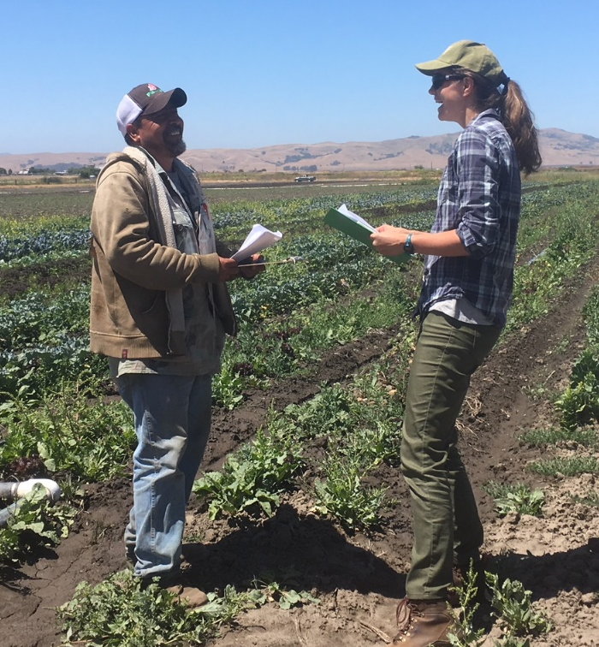
Continuing Food Safety Outreach and Education for
Local Food Systems in California
Kali Feiereisel, Community Alliance with Family Farmers, kali@caff.org
USDA, NIFA, FSOP
In Progress
Problem Statement / Issue Definition:
Over 16,000 farms under $500,000 in sales that need to be in compliance with FSMA in CA
2,300 Qualified Exempt Farmers
Approach / Methods:
Technical assistance at workshops 1-on-1
Webinars
Partner Farm Program
Results / Outcomes:
2 of 3 webinars done – 107 total attendees, 19 questions answered, average change in knowledge
114 number of people helped 1-on-1, 288 questions answered
11 workshops to 166 number people, 99 questions answered
Food Safety Outreach Project Round Table

Slide 9
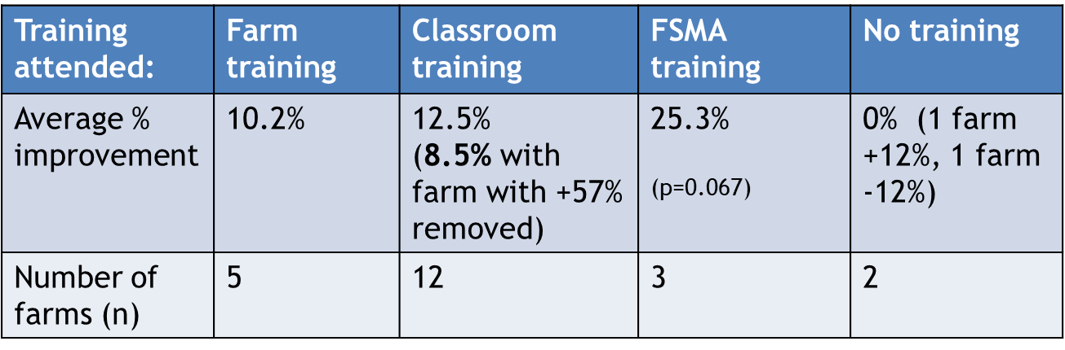


Strengthening food safety education and outreach for Kansas and Missouri fruit and vegetable producers
Londa Nwadike, Kansas State and Univ of Missouri, lnwadike@ksu.edu
USDA NIFA, Food Safety Outreach Grant 2016-70020-25800, 2019-70020-30358
Completed 2016 project, starting 2019 project
Problem Statement / Issue Definition:
In this project, we wanted to compare the effectiveness of on-farm and classroom training through on-farm produce safety assessments. We also wanted to assist KS and MO produce growers with understanding produce water quality
Water
Farm assessment scores
Approach / Methods:
2016 grant: 1) developed quantitative on-farm produce safety assessment; conducted assessment before and after trainings; 2) develop traceability app; 3) provided free water testing
2019 grant: Develop water quality training materials, E. coli source tracing, treating surface water for post-harvest use, free water testing
 | Total (n=378) | Surface (n=185) | Ground (n=170) | Other (n=23)
0 MPN / 100mL | 183 | 28 | 138 | 17
1- 126 MPN/100 mL | 162 | 128 | 28 | 6
127-410 MPN/100 mL | 11 | 8 | 3 | 0
411- 2419.6 MPN/100 mL | 16 | 15 | 1 | 0
> 2419.6 MPN/ 100mL | 6 | 6 | 0 | 0
Results / Outcomes:
2016: 1) produce growers improved their produce safety practices; 2) developed app.farmament.com to generate traceability QR code and search function; 3) provided water testing results to KS and MO farmers. This work informed development of 2019 FSOP project on water quality for KS and MO produce growers.
Water test results in 2016 project
Food Safety Outreach Project Round Table

Slide 10
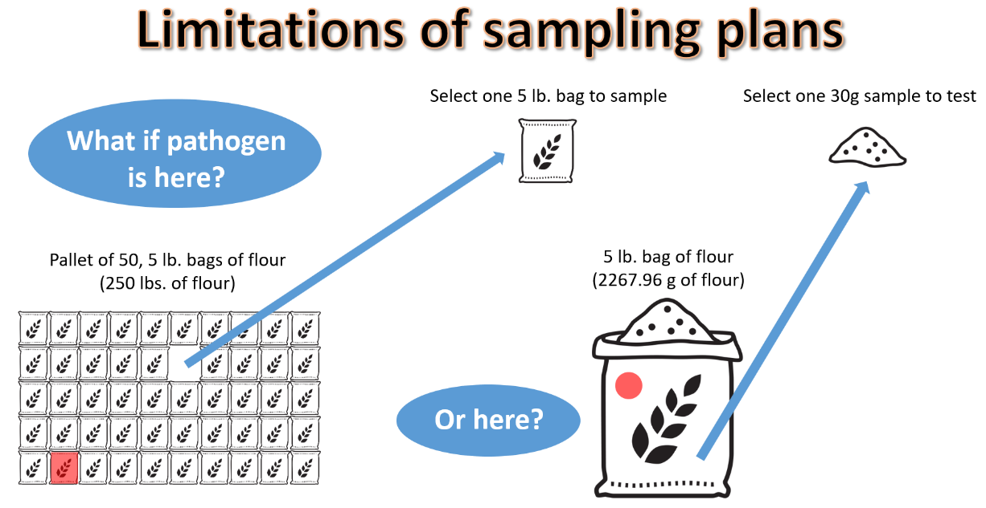
Integration of food quality assurance programs with FSMA preventive control compliance
Erin DiCaprio, UC Davis, eldicaprio@ucdavis.edu
End 8/31/2020
Targeting small processors
Assist in understanding the overlaps between the PCHF Rule and existing QA programs
Webinars (June 2019; Feb 2020)
Overview of quality assurance
Microbiological sampling
Environmental monitoring programs
Tools for quality control
Food Safety Outreach Project Round Table

Slide 11







National Dairy Food Safety Coaching Workshop
Samuel Alcaine, Cornell, alcaine@cornell.edu
Co-PI: Clint Stevenson, NC State; Dennis D’Amico, UConn, Tim Stubbs, ICfUSD
USDA, Food Safety Outreach Program
{On Going}
Problem Statement / Issue Definition:
Artisan Dairy Producers Response to PCQI training
Overwhelmed, unsure where to start, unsure how to translate the examples to their products, unable to afford classes, unaware of requirements.
Approach / Methods:
Developed a 2-day workshop based on the FSPCA material/1-day version for conferences for $49
Added dairy examples, paper and digital templates
Partnered with University Extension & Regional Guilds/Dairy Organizations
Added breakout sessions for participants to develop/review specific sections of the food safety plan with food safety coaches and peers.
Pre & Post Survey to gauge knowledge, progress, and attitudes towards food safety plan. 1 year follow up survey.
Results / Outcomes:
12 Workshops – NY, OH, OR, PA, NC, IA, MD, ME, VA, CA, SC
200+ Participants
Feedback is positive, some found value in taking it multiple times.
Wide range of progress.
2020: MA, MN, NYC, OR, FL, UT, MD(?)
Food Safety Outreach Project Round Table

Slide 12
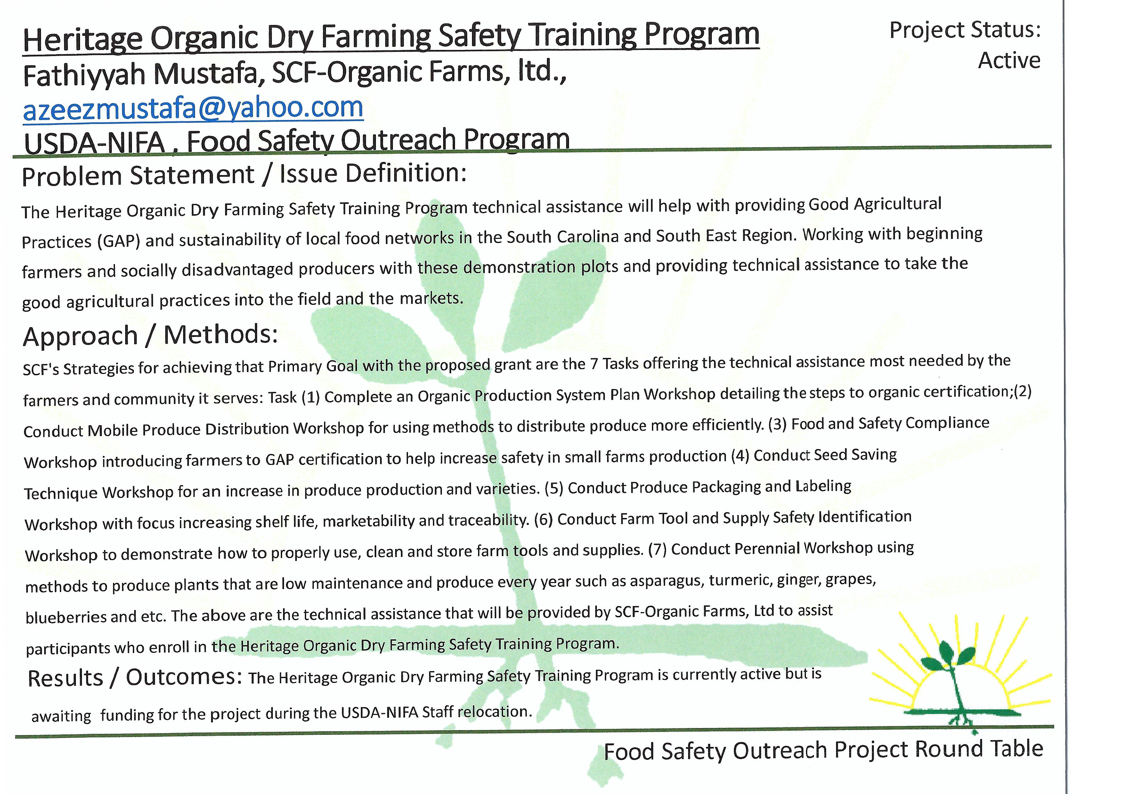

Slide 13


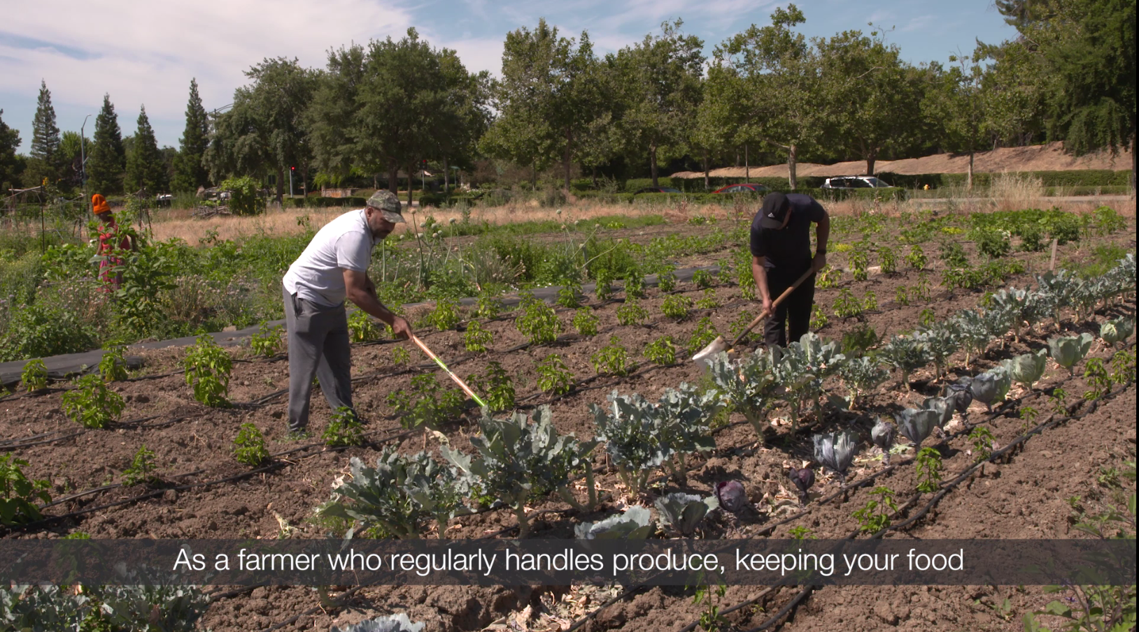

Immigrant and Refugee Food Safety Project
Eric Spring, International Rescue Committee, eric.spring@rescue.org
USDA, NIFA
Pilot Completed,
Expanded Project
Ongoing
Problem Statement / Issue Definition:
A growing population of refugee and immigrant farmers face many barriers to accessing resources and trainings on food safety, and compliance with new regulations. Challenges include language, literacy, lack of access to resources and incomplete knowledge of US food system regulations
Approach / Methods:
Participatory needs assessments conducted to assess background knowledge on food safety, barriers to access, and preferred learning methodologies
One food safety module developed for three groups of farmers
Private media company produced content with technical input from food safety partners and input from target audience.
Results / Outcomes:
Tailor made content created for each of the three groups:
Set of visual aids on safe chemical use in lu-Mien
Video on compost and manure use in Nepali
Video on farmer health and hygiene in Arabic.
Pre and post surveys demonstrated immediate knowledge gains between 20 to 50% for all three groups.
Next steps: Develop specific content for each group on five food safety modules; Follow up with a select group of farmers to measure change in behaviors and adoption of these best practices over a one year period.
Food Safety Outreach Project Round Table

Slide 14


Expanding FSMA Produce Safety Rule Outreach to Underserved Diversified Fruit and Vegetable Farms in Minnesota
Annalisa Hultberg, University of Minnesota Extension, hultb006@umn.edu
(in-progress through Sept 2020)
Problem Statement / Issue Definition:
MN has a large and growing number of small acreage, Latino, Hmong, African, Plain-faith growers, food hubs, non-profits and ag professionals who request simplified PSR materials. Tailored educational material and technical assistance are needed to help these groups understand 1) their coverage status; and 2) the basics of the provisions of the PSR.
Approach / Methods:
Needs assessment with advisory group of food hubs, farmers and agricultural educators provides foundation to work.
Materials: Short videos, flow-charts and simple English summaries of exemptions and exclusions and PSR basics. Translate some new and existing materials. Update existing materials and food safety plan template for PSR alignment.
Workshops: Supplemental single-topic workshops for niche-audience covered farms include hands-on activities. Pilot new materials and adjust based on feedback. Host at non-profit partner organizations and food hubs.
Train-the-trainer: Build the stable! Provide train-the-trainer outreach with ag professionals, food hubs and farmer co-ops.
Results/ Outcomes:
Materials: 7- minute video on coverage status (will be translated into Spanish and Hmong); Updated 8 GAPs and PSR factsheets; New exemptions flowchart; Updated Farm Food Safety Plan; Factsheets for distributors/buyers (planned)
Workshops: Workshops for Latino, Hmong and other immigrant growers (coverage status, GAP audits, employee training, water testing, writing a food safety plan). 3 to date, 3 more planned for late winter/spring 2020. All workshops in collaboration with partner orgs and food hubs. Amish Grower Training.
Train-the-trainer: Outreach to ag non-profits, food hubs; 1 webinar and outreach to food hubs and distributors (planned summer 2020)
Food Safety Outreach Project Round Table

Slide 15

Colorado Produce Safety Collaborative:
Regionally Adapted Training and Outreach
Adrian Card, Colorado State University Extension, Adrian.Card@Colostate.edu
USDA-NIFA | Food Safety Outreach Program
Active, Unfunded
Problem Statement / Issue Definition:
Colorado has a diverse learner continuum of farmers with common and regionally specific produce safety educational needs. Some early adopters are making progress on produce safety while others are lagging on PSR training and food safety plan development. This project will address learner stage and regional differences to increase produce safety awareness, knowledge and technical skills.
Approach / Methods:
An advisory committee of produce farmers from 4 regions of Colorado will inform program development. Outputs include: mentorships, in person trainings, webinars and tours on: intro produce safety, FSMA and PSR updates, technical skills, risk assessment, GAPs. Evaluation methods include: on-site and online surveys, webpage analytics, AFDO/PSA post surveys, pre and post mentorship surveys.
Results / Outcomes:
Currently we are recruiting for advisory committee members and planning for intro produce safety meetings, FSMA and PSR update webinars, technical workshops, and a webinar on risk assessment. To date, funds have not been disbursed for this 3 year project.
Food Safety Outreach Project Round Table

Slide 16
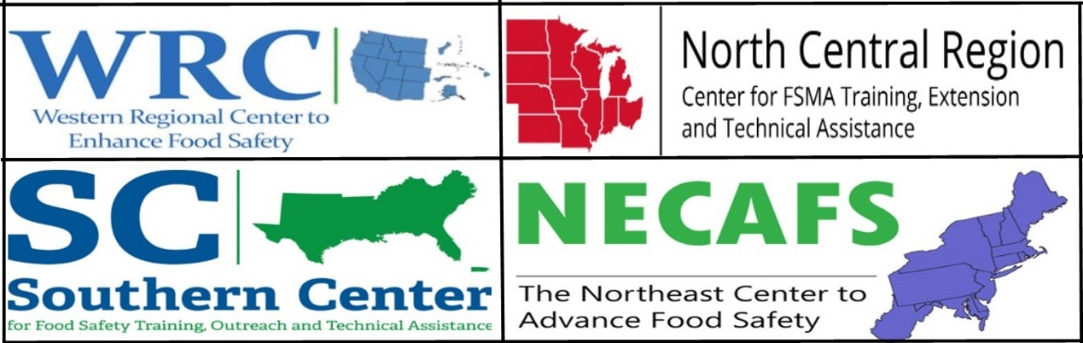
Food Safety Outreach Project Round Table
December 16, 2019
Questions?

